Slide 1
PACE ANALYTICAL
ENVIRONMENTAL SCIENCES &
FIELD SERVICES DIVISION
Daniel George
Isaac Schmidt

Slide 2
AGENDA
How to Collect Viable Leachate and Groundwater Samples
Why Collecting Viable Samples Matters
Leachate Sampling Scenarios
Groundwater Sampling Scenarios
PFAS & Sampling Suggestions
Compounds of Emerging Concern
Field Documentation & Resources

Slide 3
Why Collecting Viable Samples Matter
1
Health of Landfill
-Leachate is a key end product of the reactions taking place within the landfill between solid waste, microorganisms, and moisture.
-Various laboratory analysis including BOD₅, COD, ammonia, pH, and TSS can help characterize the landfill
-Degree of stabilization –Point towards problems of groundwater ingress, excessive recirculation, or presence of unusual wastes
-Following improper procedures can skew analytical data obtained from samples, leading to an inaccurate characterization
-Good sample collection procedures matter so the data collected is an accurate characterization
2
Permit Compliance
-Ensures that leachate data falls within parameters outlined by the permitting body
-Determine if the landfill is functioning properly
-Determine if leachate is suitable for off-site transport and disposal or application

Slide 4
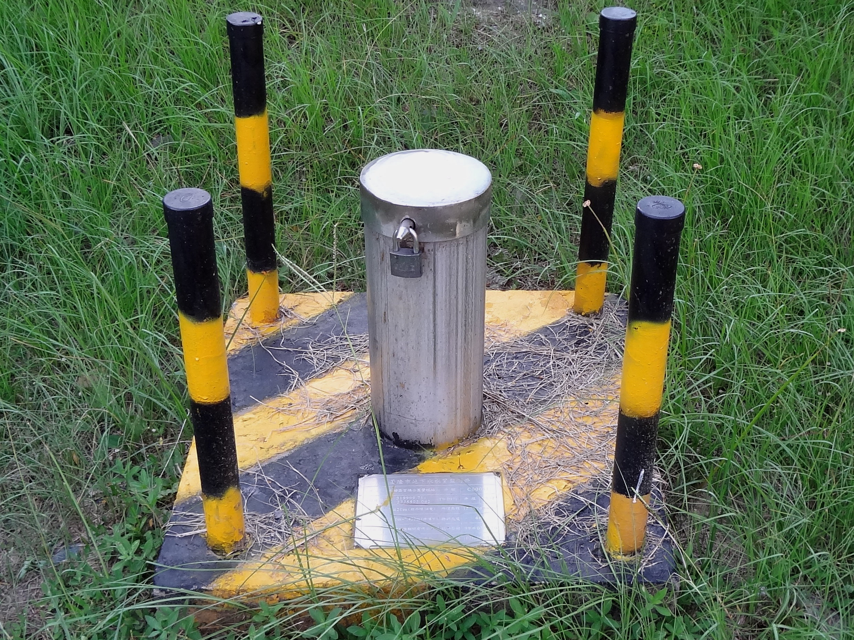
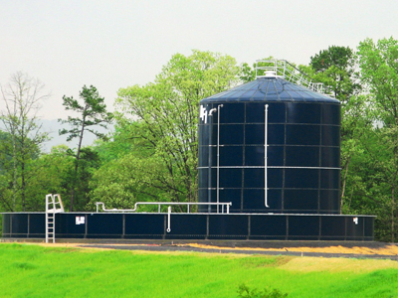
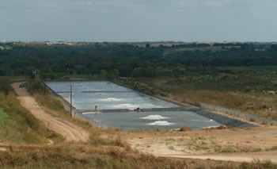
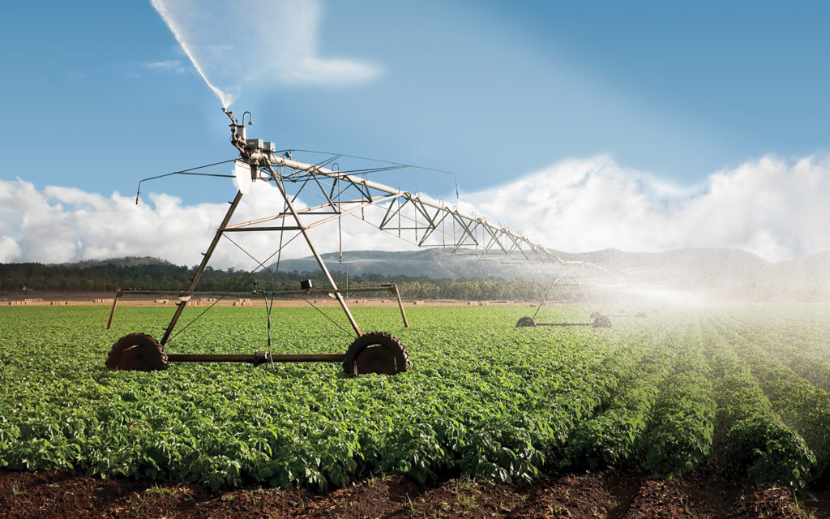
Leachate Monitoring Scenarios
1
Leachate Collection Well
2
Storage Tanks
3
Post Application Monitoring Well
Leachate Pond
4

Slide 5
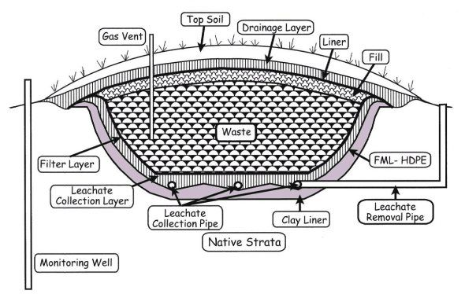
Leachate Collection Well
Proper Collection Technique & Equipment
Low Flow Pump and Sample Cell
Helps with Recharge
Don’t need to purge a large volume
Field Parameters Near Stable
Teflon Tubing
Make sure sample collection does not overly agitate leachate
Also make sure collection is not just from the top portion of leachate in well
Top portion may have volatilized
Bottom may contain unrepresentative sludge/solids
Notes:
Low Flow Sampling – Using Peristaltic pump/bladder pump. This allows for proper recharge of monitoring well and ensures a representative sample. Purging to fast, damage pump, draw down the well to fast and draw unrepresentative solids. Low flow allows for a large amount of volume to be purge. 3 Volume Pruge Less Then .5 LPM

Slide 6
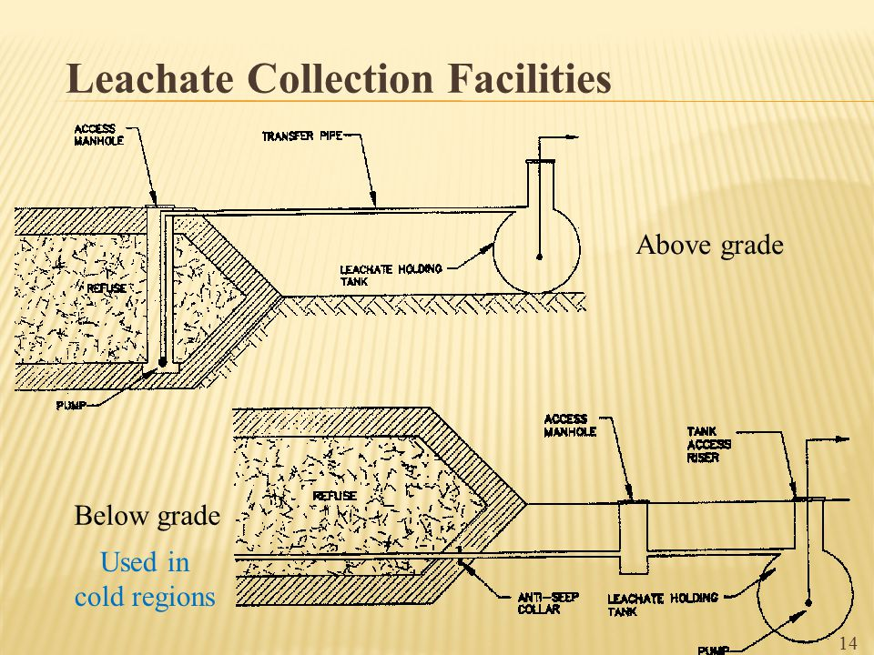
Storage Tanks/Leachate Pond
Proper Collection Technique
Teflon Tubing
Make sure sample collection does not overly agitate leachate
Also make sure collection is not just from the top portion of leachate in tank, utilize bailer or pump to get a representative sample
VOC procedures
Turn off your vehicle
Don’t use products that contain VOCs prior to sampling
Wear proper gloves
Fill glass bottle as direct as possible

Slide 7
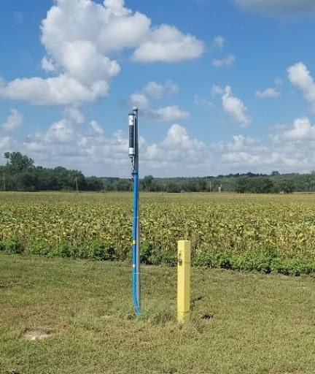
Post Application Monitoring Well
Proper Collection Technique
Low Flow Pump and Sample Cell
1 LPM purge rate taking a field reading every 5 minutes
Field Parameters – Using YSI Pro Plus
Teflon Tubing
Dedicated field monitoring pumps, Don’t need to worry about field sampling procedures affecting results.
Notes:
Dedicated pumps – cost effective, low maintenance, can last up to 10 years if taken care of properly. If water is to turbid it can hard the pump

Slide 8
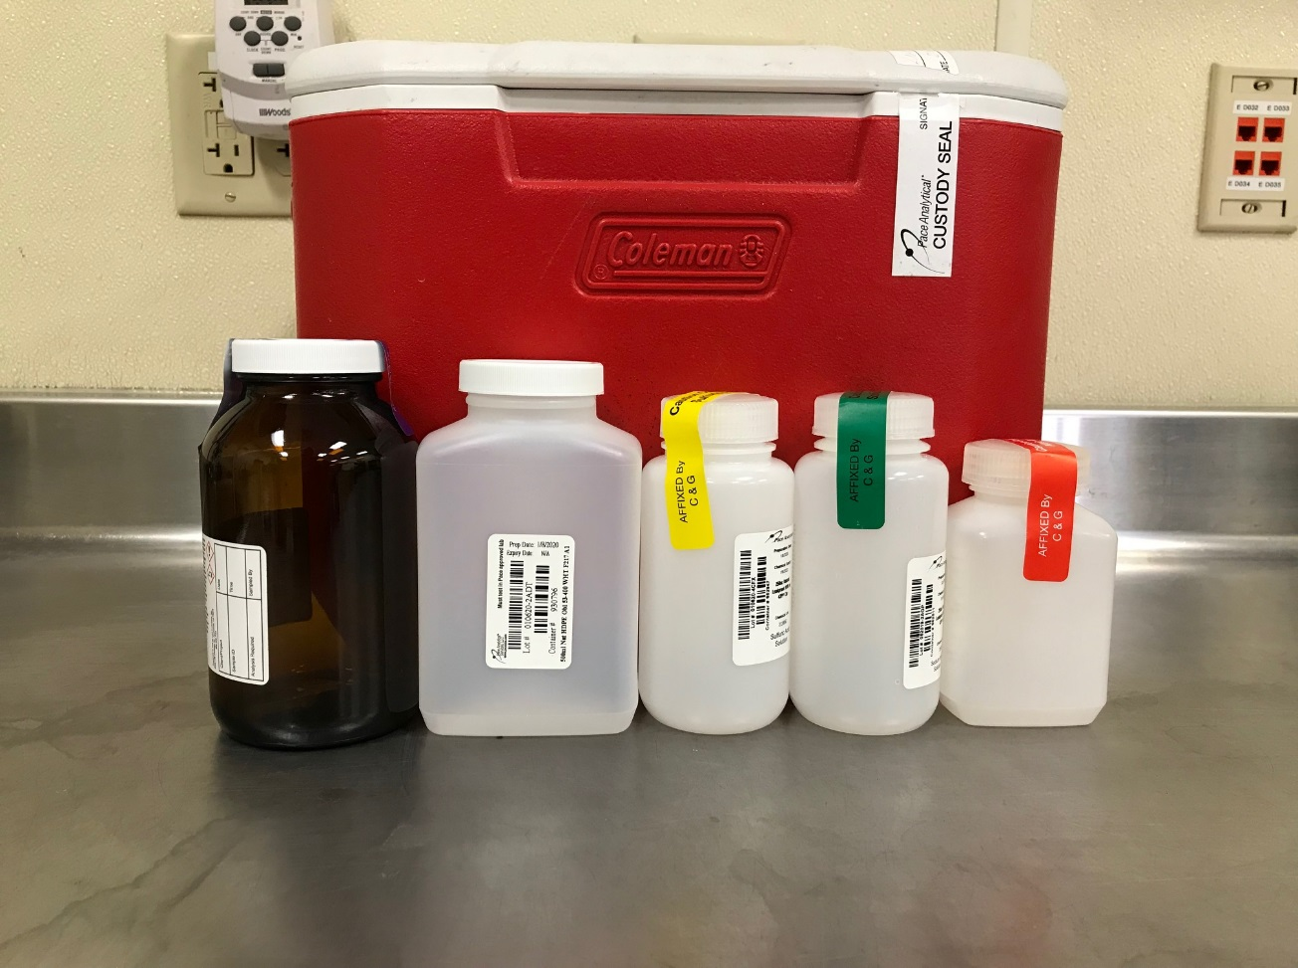
Filling Lab Bottles
Proper Collection Technique
Filling VOC vials
Leachate reacts with preservative and causes foam. Bubbles are ok but only want approximately 6 mm in diameter of total
Be aware of bottles containing preservatives
Fill bottles to neckline
If sample is known to have a high or low pH let the lab know
Notes:
When collecting from a pond use a glass transfer device, plastic bottles may contain/leach trace VOCs, especially with volatile nature of leachate. Want to fill 40 mL vials as direct/fast as possible so VOCs don’t

Slide 9
PFAS is the Wild West
Lack of federal regulation
Non-uniformity of state regulation
Non-uniformity of test methods
Lack of environmental test methods
Variety of compound lists
Thousands of PFAS compounds
Low DLs vs contaminated matrices
Ultra restrictive field sampling guidance
All this conspires to lead to uncertainty & a highly consultative process

Slide 10
Overview
Per- and polyfluoroalkyl substances (PFAS) are a large, diverse group of manufactured compounds used in a variety of industries:
Aerospace, automotive, apparels, food packaging, fire-fighting foams, non-stick coatings/cookware, carpeting & metal plating
PFAS are anthropogenic chemicals and do not occur naturally in the environment.
Phonetically: PFAS = PF +

Slide 11
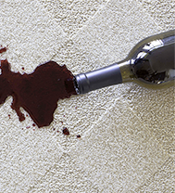
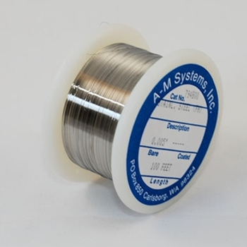
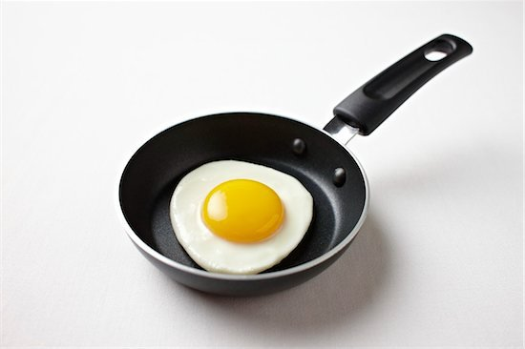
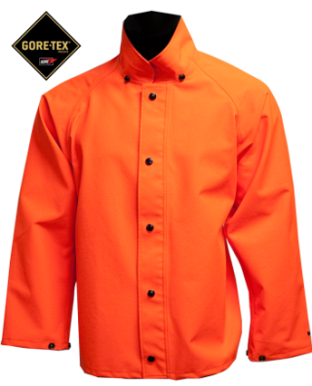
Common Sources
Textiles and Leather: factory and consumer applied coating to repel water, oil, and stains
Paper Products: surface coatings to repel grease and moisture
Metal Plating and Etching: corrosion prevention, wear reduction, surfactant, fume suppressant
Wire Manufacturing: coating and insulation
Pesticides, cleaning products, polishes, photo processing

Slide 12
PFAS in Water
Wastewater Treatment
Consumer and industrial use of PFAS-containing materials, including disposal of landfill leachate and firefighting foam, results in the discharge of PFAS to wastewater treatment plants (WWTPs). NE states are working to establish regulations to limit PFOA & PFOS to WWTP.
WWTP Operations
Conventional sewage treatment methods do not efficiently remove PFAS
Conventional treatment processes can change PFAS concentrations
Increase in PFAA due to transformation of precursor PFAS

Slide 13
Not just in water
WWTP Biosolids
PFAS have been found in domestic sewage sludge
More than half of the sludge produced in the United States is applied to agricultural land as biosolids
Application of biosolids as a soil amendment can result in a transfer of PFAS to soil
PFAS can enter the food chain through the use of biosolids-amended soil
PFAS concentrations can be elevated in surface and groundwater in the vicinity of agricultural fields that received PFAS contaminated biosolids

Slide 14
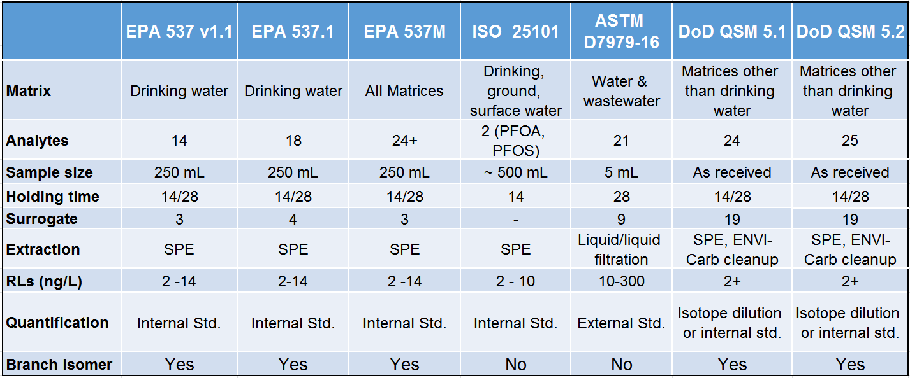
PFAS Methods
Additionally, DoD QSM 5.3 newest method 533 which is isotope dilution.

Slide 15
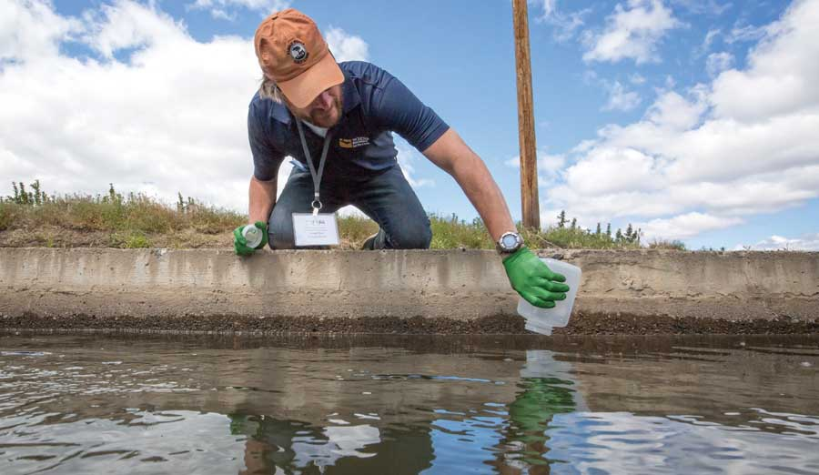
PFAS Monitoring
Proper PFAS Collection Technique
Test Prep
Clean pumps
Laboratory supplied PFAS free deionized water
New/dedicated Tubing (HDPE Tubing)
Confirm additional sampling equipment is PFAS free or has been decontaminated
Easy to use FDS which help keep track of notes/results
PFAS Sampling
Collect PFAS Sample First
Don’t place sample bottle cap on any surface
Do not use Teflon Tubing, HDPE Tubing is preferred
Place each sample in a plastic bag.
It is recommended to use Field Reagent Blanks (FRB)

Slide 16
Contaminants of emerging Concern
Fluorotelomers – part of PFAS family – AFFF
Microbeads/Microplastics
Pharmaceuticals in GW

Slide 17
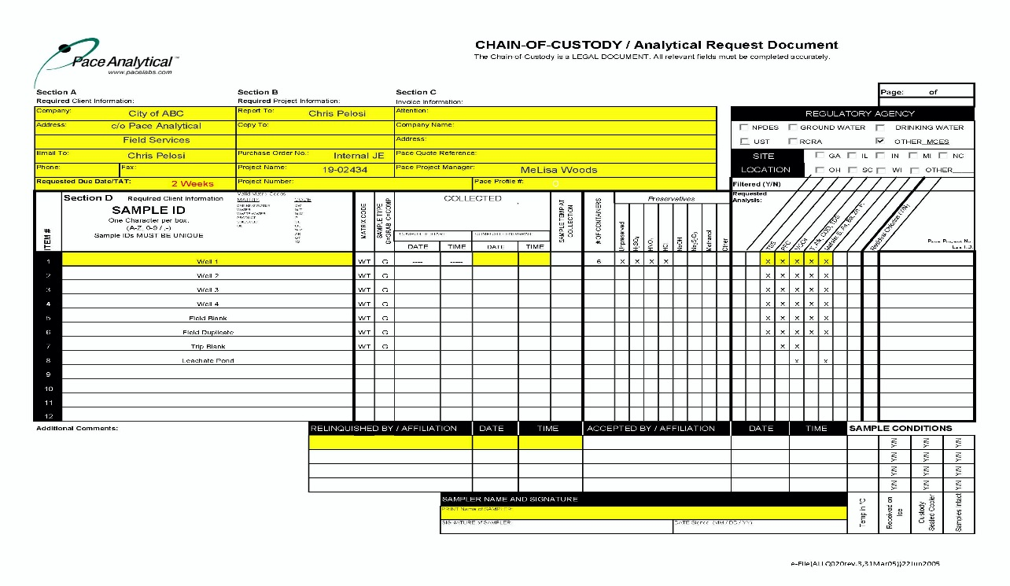
Chain of Custody & Why It Matters
Proper Collection Technique
Fill out COC completely
Client/contact information
Use permit related Sample ID when necessary
Double check analytical parameters
Turn Around Time (TAT)
The more information the better
Pack your cooler properly
Helps ensure samples are received in the proper testing condition
Loose ice is most effective means to keep samples coolest in the cooler, which is cool.
Fill out any field sheets with notes and observations
Improperly filled out COC could cause delay in analytical results

Slide 18
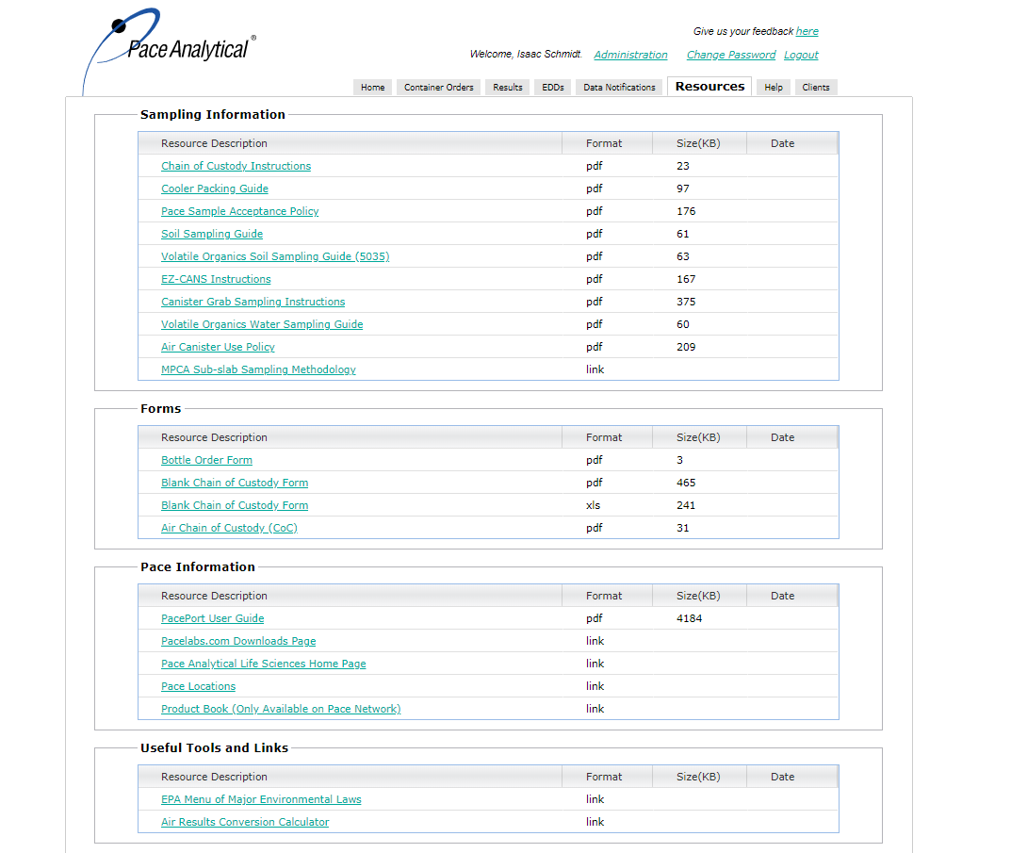
Resources

Slide 19
THANK YOU

